Slide 1
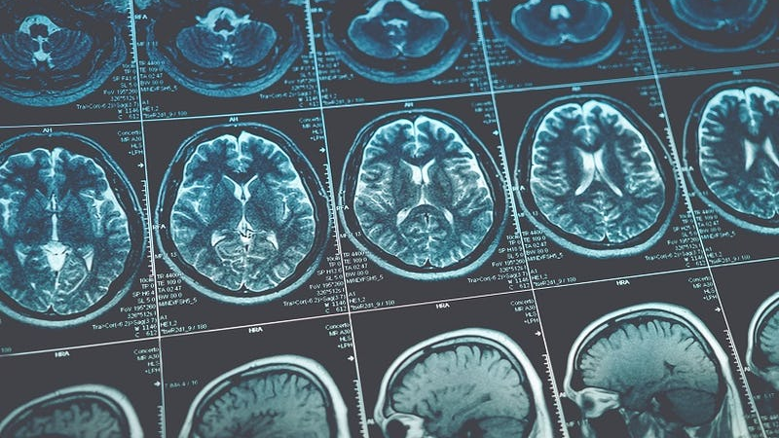
Visual Recognition for GBM and MET tumoral image with FuseMedML
Unina – Cognitive Computing System
Benfenati Domenico– M63001165
Caradente Vincenzo-M63001229

Slide 2





Machine Learning Process
Business understanding
Data understanding
Data preparation
Modeling
Evaluation
Business understanding

Slide 3

Machine Learning Process
Business understanding
Data understanding
Data preparation
Modeling
Evaluation
Business understanding

Slide 4



Business Understanding
Image acquisition
Object detection
Object classification
Determine which type of tumor appears in a certain image
Notes:
Fase 1: acquisire l’immagine
Fase 2: rilevare le regioni che sembrano contenere uova
Fase 3: determinare se le regioni contengono o meno uova

Slide 5
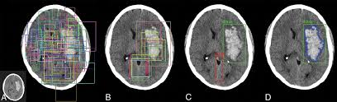
Business Understanding
Given a set of MRI images, the goal of our analysis is to be able to recognize which of them present a GBM tumor or not, using a prediction model.

Slide 6
Data Mining Tools
Python
FuseMedML
Matplotlib
PyTorch
Colab
Software tools used to face the problem

Slide 7

Machine Learning Process
Business understanding
Data understanding
Data preparation
Modeling
Evaluation
Data understanding

Slide 8
Data Understanding
Image
Path
GBM
MET
Label
Subclass
WT
IDH
…
Each training image is characterized by different attributes, such as the path, the class and the type of tumor

Slide 9
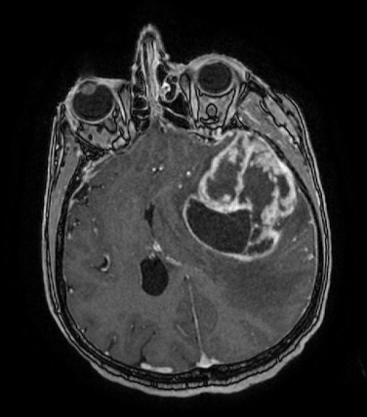
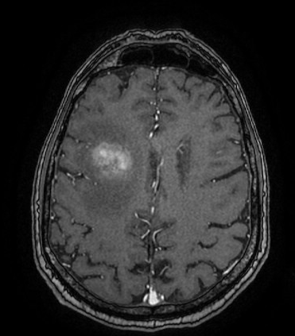
Data Understanding
GBM
WT
IDH1
MET
VESCICA
MICROCITOMA
IDH2
SEMINOMA
PANCREAS
MICROCTOMA
MELANOMA
MAMMELLA
ADENOMA

Slide 10
Data Understanding
Build a dataframe containg the information extracted
Compute some basic descriptive statistics about data
Extract some useful information from the image dataset

Slide 11
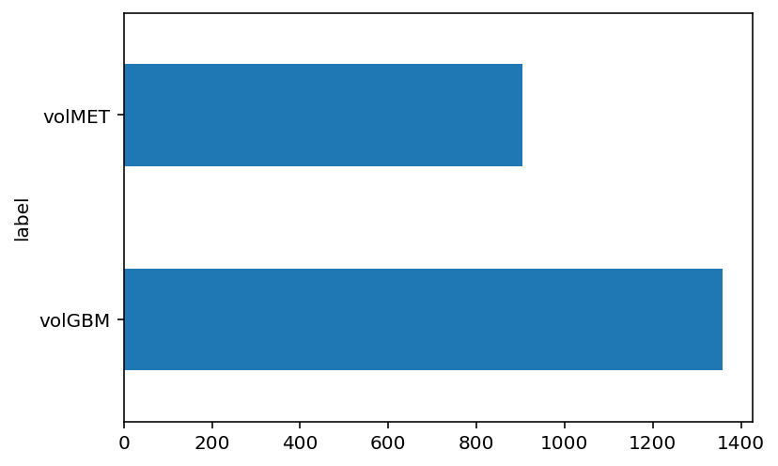
Data Understanding
We can see that we have an unbalanced dataset. The number of images of volMET is less than the number of images of volGBM.

Slide 12
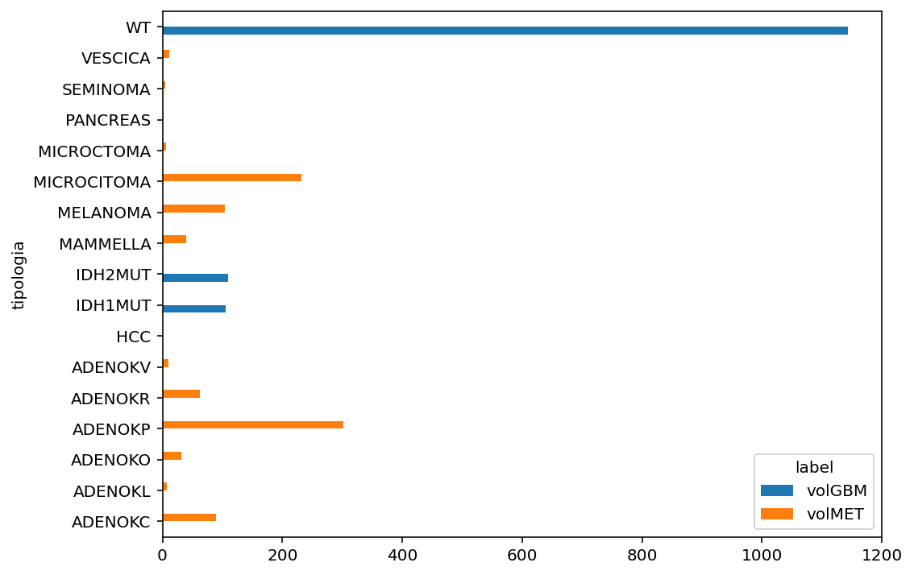
Data Understanding
The distribution of the subclasses is also unbalanced, with each subclass belonging to only one label

Slide 13
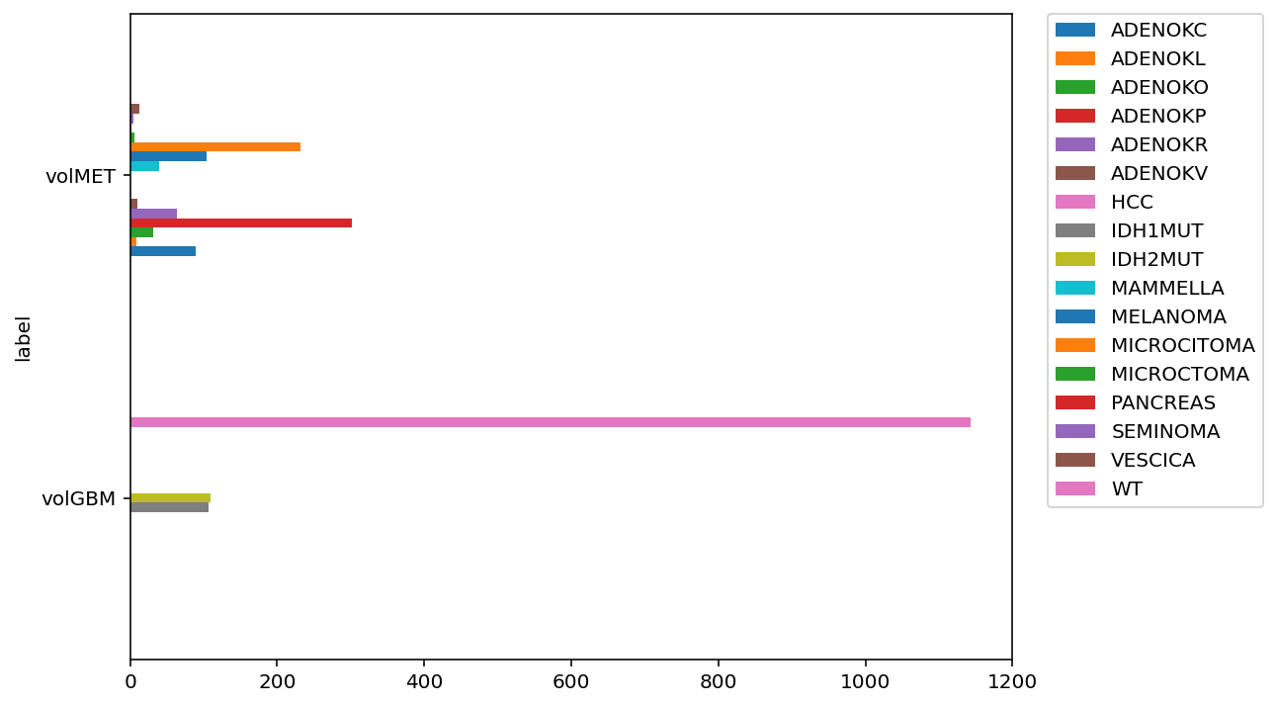
Data Understanding
So, each class have a different samples of some subclasses. We decide to not consider the subclasses as a relevant categorization of the image itself

Slide 14

Machine Learning Process
Business understanding
Data understanding
Data preparation
Modeling
Evaluation
Data preparation

Slide 15
Data Preparation
Dataset
Validation set (20%)
Evaluation
Full Training set (80%)
Local test set (20%)
Hyperparams Tuning
Training set
(60%)
Apply random holdout, to split the dataset in three parts.

Slide 16
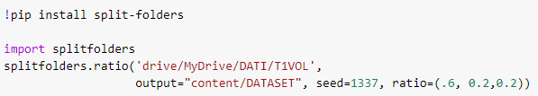
Data Preparation
Folder to split
The split described above was possible thanks to the splitfolders library, which allows you to define split percentages for your dataset
Splitted output folder
Split percentages
(train, validation, test)

Slide 17
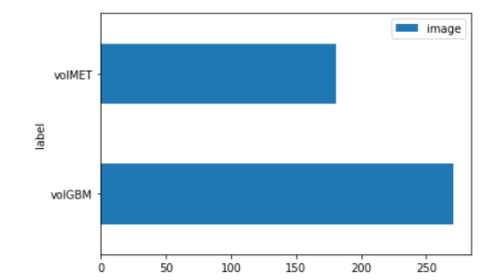
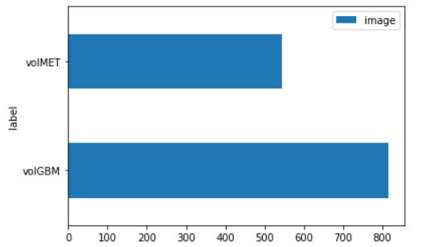
Data for Hyperparameters Tuning
Training set
Validation set

Slide 18
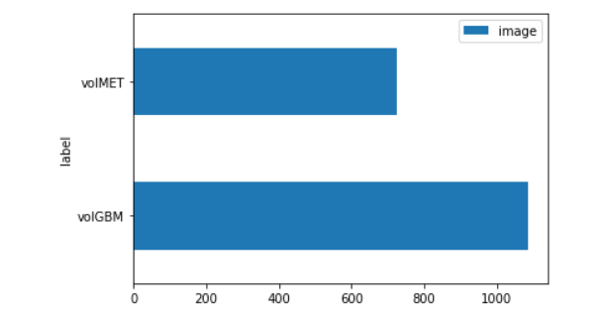
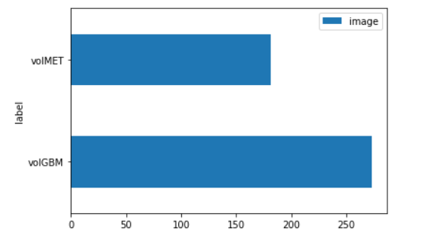
Data for Evaluation and Model Selection
Training + Validation set
Local test set

Slide 19
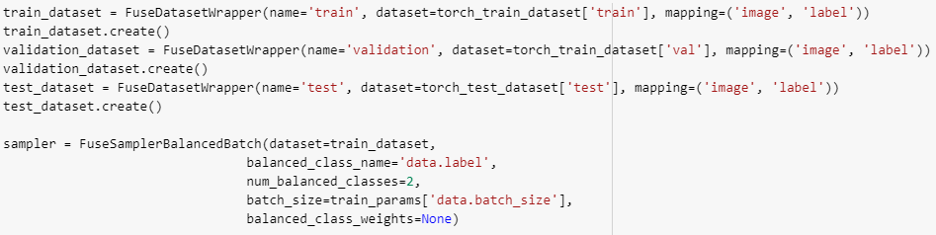
Data Preparation
Torch dataset
Fuse dataset name
After the split of data, it’s necessary to wrap the three part of the dataset with the ad-hoc FuseMed function, called FuseDatasetWrapper, and divide in batch the train dataset for the training of the model
Number of class to balance into the batches
It’s possible to give a different weight to the class in the batches

Slide 20

Machine Learning Process
Business understanding
Data understanding
Data preparation
Modeling
Evaluation
Modeling

Slide 21
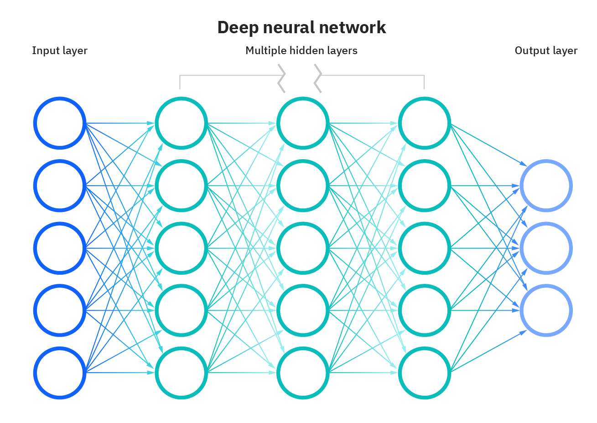
Modeling
VGG11
8 convolutional layers
Dropout
3 dense layers
About 20 total layers
Use the pretrained Convolutional Neural Networks (CNNs), provided by PyTorch

Slide 22
Modeling
Set model’s hyperparameters
Train the model (training set)
Evaluate model’s performance (validation set)
Evaluation of the metrics (loss and accuracy)
Repeat the whole process for each epochs defined before

Slide 23
Hyperparameters Tuning
Hyperparameter | Description
Trained layers | Layers whose parameters are learned
Batch size | Size of mini batches
Number of epochs | Number of training epochs
Loss function | Function to minimize during training
Optimizer | Optimization algorithm used for training
Learning rate | Learning rate used by the optimization algorithm
Data augmentation | Transformation applied to training images
Tune the hyperparameters evaluating model’s performance on validation set

Slide 24
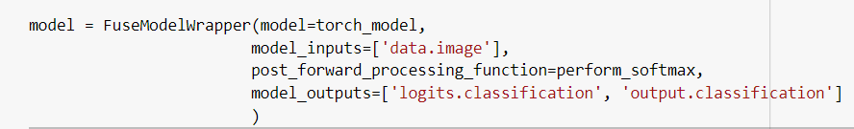
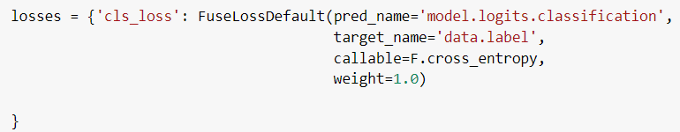
Data Modeling
Activation function
PyTorch model
Thanks to the FuseModelWrapper class we build a PyTorch model and then wrap it using Fuse function.
With the class FuseLossDefault we create a dictionary of loss elements, where each element is a class of type FuseLossBase.
The total loss is calculated as a weighted sum of all the elements of such a dictionary.
Prediction of the model
Calculate the Cross Entropy

Slide 25

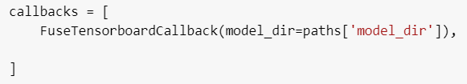
Data Modeling
Thresholds metrics: apply ArgMax function to the output predicted
Define some metrics with Metric classes of FuseMedML, they will be calculated during the training phase.
Define a FuseTensorboardCallback to save the best state of the model during the steps of the training.
Accuracy:
calculate the accuracy of the batch according to the prediction and the target label
TensorboardCallback: save the parameters of the model into a board of Torch

Slide 26
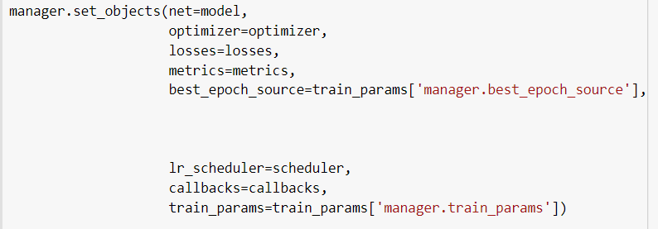
Data Modeling
Path of the model
Create a FuseManagerDefault to coordinate all the operation during the training phase.
Set the Manager attributes with the function set_objects, as we define before

Slide 27
Ex: Tuning the Learning Rate (VGG11)
Good learning rate
High learning rate
Low learning rate

Slide 28
Ex: Tuning the Epochs
Good number of epoch

Slide 29
Final Hyperparameters
VGG11
Hyperparam | Value
Trained layers | Fully-connected + last convolutional
Batch size | 40
Number of epochs | 50
Loss function | Cross entropy
Optimizer | Adam
Learning rate | 1e-4

Slide 30

Machine Learning Process
Business understanding
Data understanding
Data preparation
Modeling
Evaluation
Evaluation

Slide 31
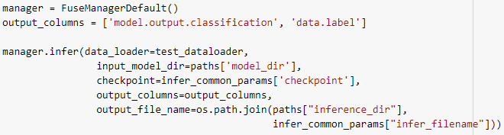
Parameter inference
Default Manager
Saved parameters of the model
Once the network is trained, the saving state of the model is used to make the prediction on the local test set, creating a new Manager instance and using its function infer.
Path of the output prediction

Slide 32
Evaluation
Training set
Training
Hyperparams
Model
Prediction
Local
Test set
Evaluation
Evaluate models’ performance on an independent test set

Slide 33
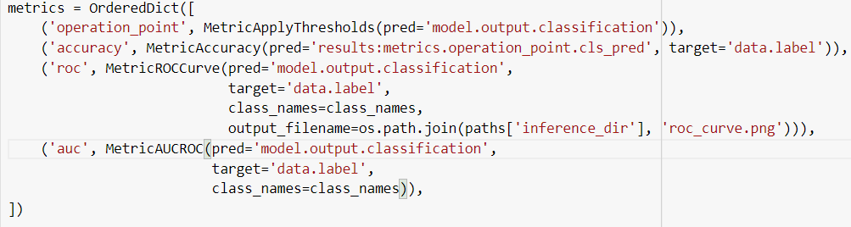
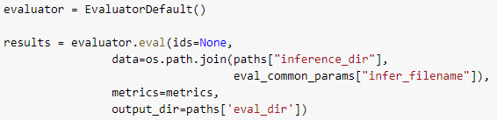
Evaluation
Metrics dictionary
For the evaluation of the model performance, we can define our personal metric to calculate on the test set. We choose Accuracy, ROCCurve and AUCROC for the ROC Curve Accuracy.
Using an Evaluator, we use the function eval to measure the metrics defined before
Evaluator instance
It can be used also without Fuse
Evaluation process
Calculate the metrics and save them into a directory

Slide 34
Final Evaluation
On our Local Test Set, that is indipendent from the Training set, the results show that the accuracy is about the 94,5%

Slide 35

Thanks for your attention!

